Slide 1

Automated Wine Recommendation
Group members: Aitong Su, Emily Ziyi Xiao, George Li, Han Wang

Slide 2
Consumers’ Journey
Awareness
Selections
Decisions
Start shopping for wine
Choosing the favorite from thousands of wine
Making the purchases through on/off-premise channels

Slide 3
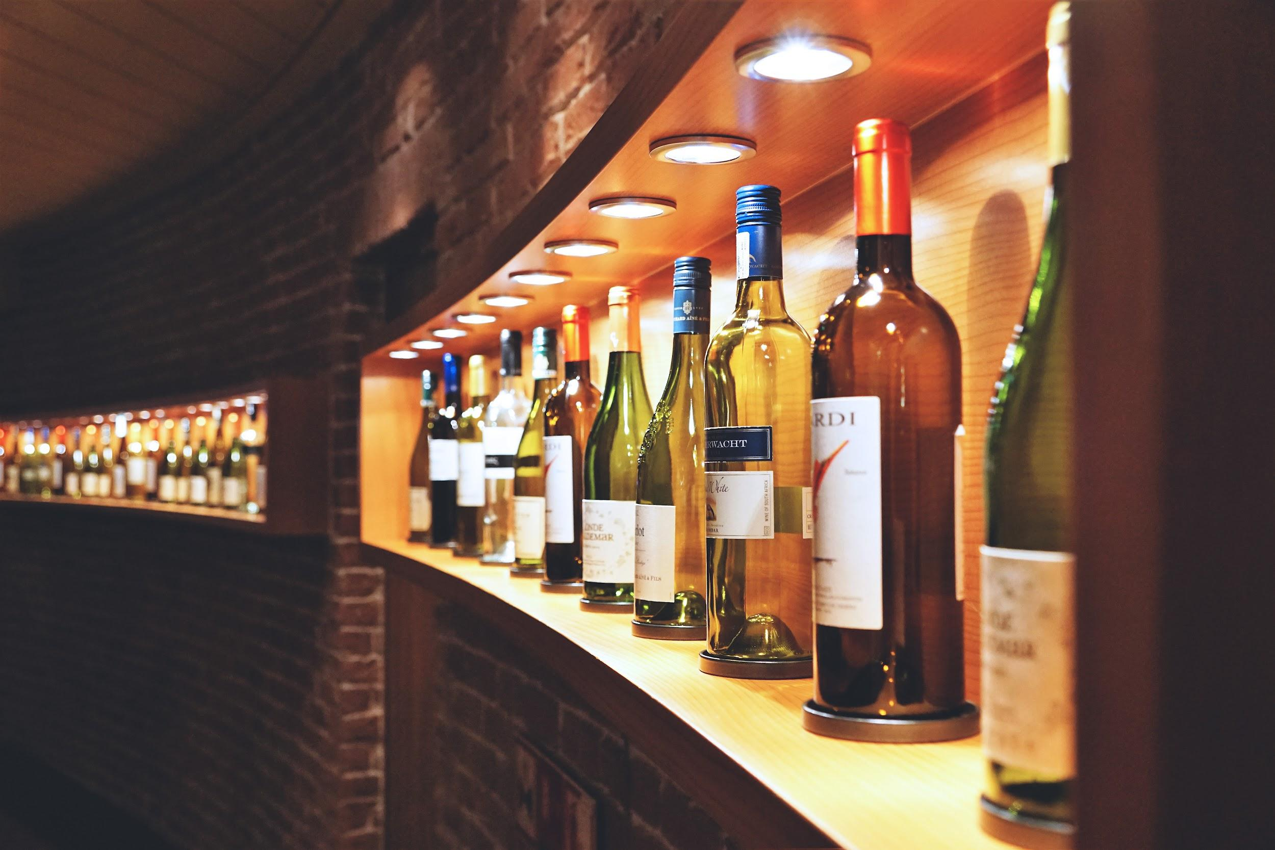
Problem Statements
The wine market has continued to slump in recent years:
High harvests and trade conflicts
COVID-19 pandemic
Changes in consumer spending habits
Product quality raise consumer’s attention

Slide 4
Questions and Hypotheses
Q2: What are the overall performance of the classification models（Regression model, Decision Tree and User-Based Collaborative Filtering) in predicting wine variety ?
Accuracy, Precision and Sensitivity
Confusion Matrix(Type I and Type II error)
Hypothesis: UBCF perform best among all the classification models
Q1: How does the sentiments of consumers affect their likelihood of the wine?
Correlation between positive reviews and wine points
Hypothesis : positive correlation between wine points and amount of positive words in reviews
Notes:
Our hypothesis is that the sentiment analysis will show that there is a positive correlation between the amount of positive words in one’s wine review and the score rated by the same person for that wine. For the prediction, it is hypothesized that the recommendation lab will perform best among all the classification models, as it can generate results in a user-based model.

Slide 5
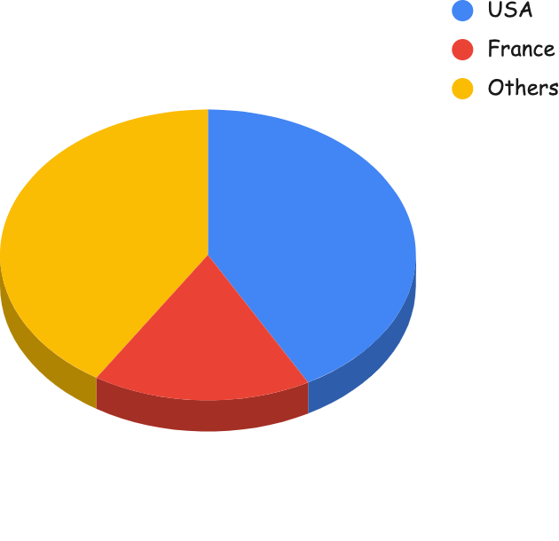
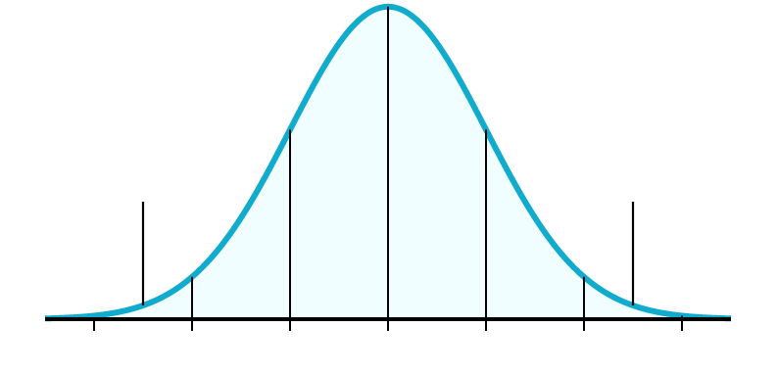
Data Description
Overview
Collected from Wine Enthusiast
Sample size: 130 thousands
US market focused
2 Types of Variables
Basic information and geographic information
Reference for wine recommendation
Basic Analysis
location
price
rating score
$3300
41%
42%
$35.36
17%
$4
85.41
88.45
91.34
Notes:
- Overview: In order to predict wines by inputs such as flavor, smell, and taste, we would like to use a wine review dataset to train our model. This dataset is collected from Wine Enthusiast, which is a magazine and website that specialize in wines, spirits, food, and travel. In total, the dataset has 130 thousands of unique wine samples that are either produced in the US or imported from other counties to the US wine market.
- 2 Types of Variables: Our dataset includes 10 variables that could be sorted to 2 types. The first type records the basic information and geographic information of each sample, which includes serial number, price, country, province, designation, and region. The second type of variable collects the reference information that Wine Enthusiast provides for their customer to choose wines, such as points, description, and taster_name. Points are the number of points that Wine Enthusiast rated the wine on a scale of 1-100. Description is the unique illustration for each sample that detailedly describes the flavor, smell, and taste of the wine. Taster_name records the name of the person who tasted each sample and wrote the description.
- Basic Analysis: After some basic analysis of the dataset, we could see that 42% of the samples are produced in the US, 17% are produced in France, and the rest 41% are from other countries. The average price of our sample is $35.36, with a maximum price of $3300 and minimum price of $4. The rating score that Wine Enthusiast used to rate the sample has an average of 88.45, with a standard deviation of 3.04.

Slide 6
Choice of analytical technique
Binary sentiment analysis
Sentiment Score
understand the reviews for top-rated wines
analyze and discover customer feedback
Mclust method
group data with similar characteristics
understand the variety distributions
Regression model
Decision Tree
Recommendation Lab
User-Based
Item-Based
list top 5 recommended varieties for users
help users find the wine based on their preferences
Text mining
Clustering
Prediction

Slide 7
Results Discussion
Binary sentiment analysis
There is no clear evidence showing that wines with higher score-point can have higher proportion of positive words in reviewers’ description.
Sentiment score
The results tells that a higher score has a larger value of sentiment.
Binomial regression model
There are 21 words that have certain relationships with the variety.
User-based collaborative filtering
VS
Item-based collaborative filtering
User_id | Recommended Wine | UBCF | IBCF | Avg User Ratings
user_1025 | White Blend | 87.11111 | 89.98232 | 89.33
user_1040 | White Blend | 80.90972 | 85.00000 | 88.8

Slide 8


Conclusion and Recommendations
Conclusion
Score-points does not have a high influence to products
UBCF and IBCF has completely different results
Recommendation
Look at the description and take scores as reference
Make prediction using both UBCF and IBCF

